Slide 1
Polaris Sight
Live Forensics & Incident Response System
OWEN CHARTERS
PEIJUN
RUI
CURTIS

Slide 2
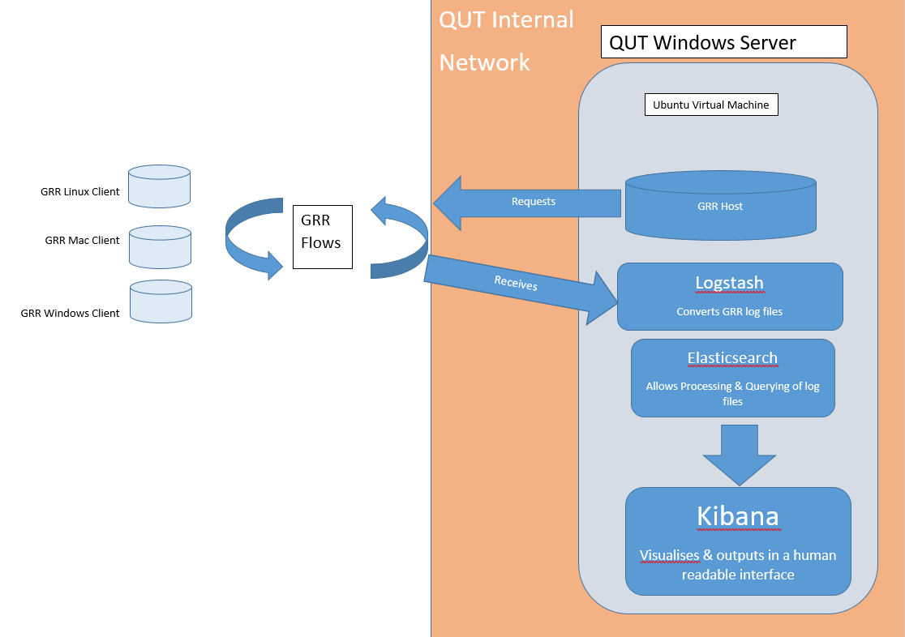
The domain
Incident Response & Live Forensics
Protect the digital assets of businesses & agencies
Scalable, Live, Remote, Open Source and easily interpretable
Conducted a formal Literature Review to ensure an understanding of the project domain

Slide 3
The plan
Release 1 - Early in the semester to assess progress and get feedback
Release 2 - Establish foundations (server configuration, logging)
Release 3 – End of semester, Tests to prove functionality
----------------------------------------------------------------------------------------------------------------------------
Release 4 – Visualisation (data selection & manipulation), Installation scripting/automation (stretch goal), GUI, Report Generation (stretch goal)
Week 6 | Holiday Week 1 | Holiday Week 2 | Week 7 | Week 8 | Week 9 | Week 10 | Week 11 | Week 12 | Week 13
Sprint 1 |  |  | Sprint 2 |  | Sprint 3 |  |  | Sprint 4
Release 1 |  |  | Release 2 |  |  |  |  | Release 3
Week 1 | Week 2 | Week 3 | Week 4 | Week 5 | Week 6 | Week 7 | Week 8 | Week 9 | Week 10 | Week 11 | Week 12 | Week 13
Sprint 5 |  |  |  |  |  |  |  | Sprint 6
Release 4

Slide 4
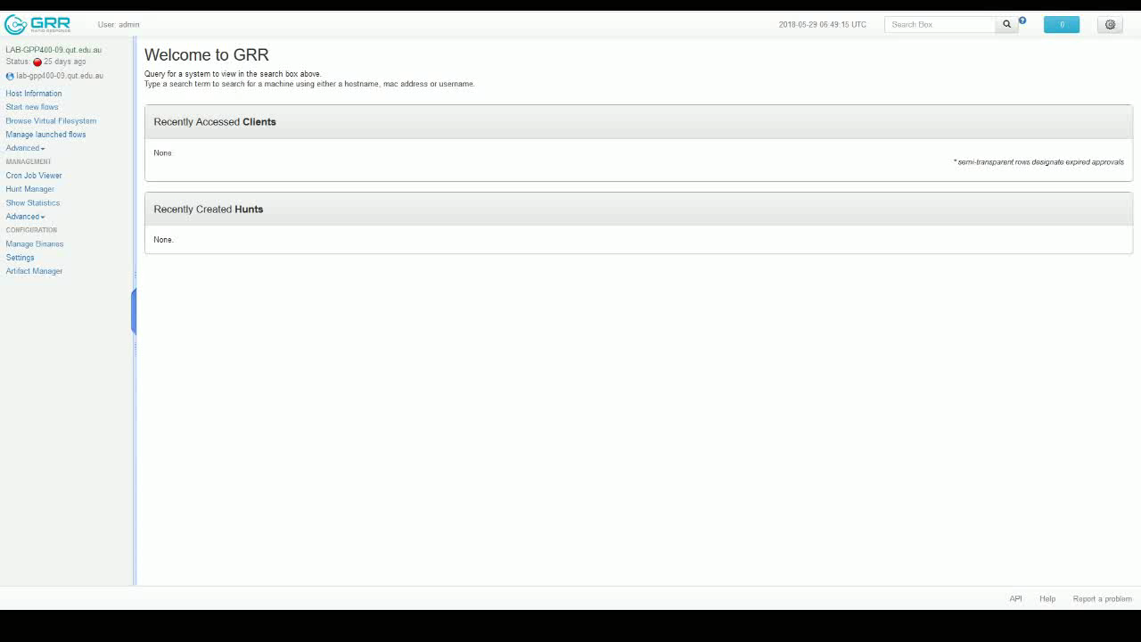

Slide 5
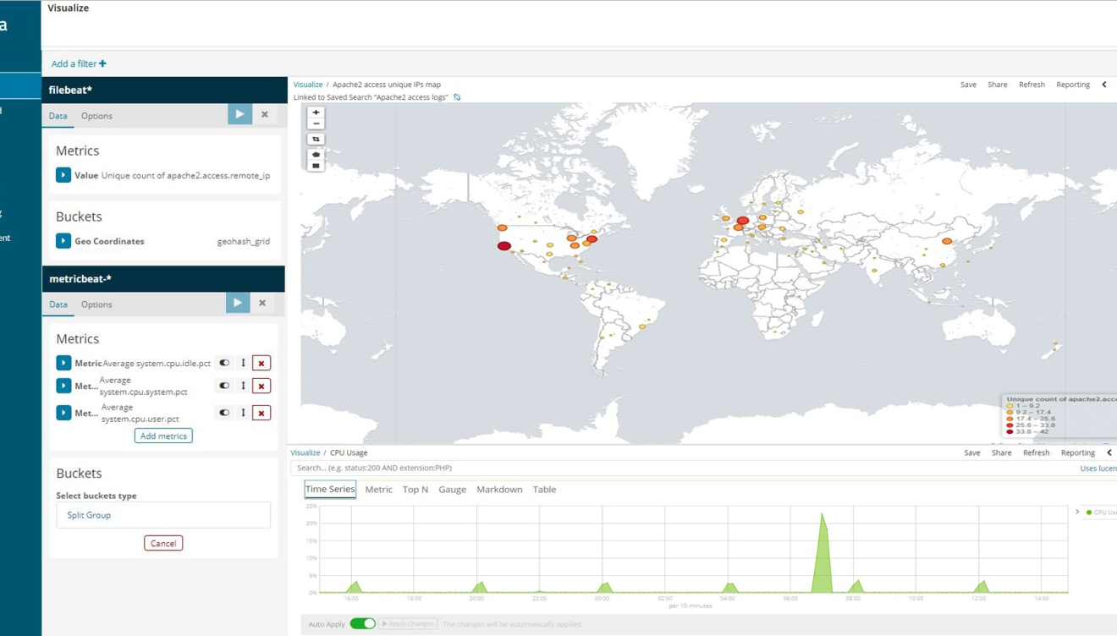
The Artefact
Kibana User Interface
“At a glance” information
Can visualise huge amounts of data
Easily determine health status of network, attack types and origins
Real time

Slide 6
QUALITY
Design Quality | Industry Engagement, Literature Review, Project Management Plan
Process Quality | Meeting Minutes, Progress Tracking, Trello, GitHub, Weekly Meeting with Client
Organisation Quality | Teamwork and Communications, Group Meetings, Different Skills
Three dimensions of quality
Design Quality
Project Quality
Process Quality
Organisation Quality

Slide 7
Credits
Progress tracking: Peijun Xue
Literature review: Peijun Xue, Rui Lin
Industry engagement: Curtis Dooley
GRR server installation: Owen Charters, Curtis Dooley
Virtual network deployment: Owen Charters

